Slide 1

ONLINE-RETAIL SALES ANALYSIS
PRESENTED BY: KOINA GARG (DATA ANALYST)

Slide 2
Agenda
Problem Statement.
Data set overview.
Data cleaning.
EDA.
SQL analysis.
Power BI Dashboard.
Key insights.
Conclusion.
Q&A.

Slide 3
Problem Statements:-
Dataset Overview
Data source: Kaggle (Online retail sales).
Rows:- ~540,000+ & columns : 8
Key Field: Invoice No, Stock code, Description, Quantity, Invoice date, Unit Price, Customer ID, Country.
Understand customers’ purchase behavior.
Identify top-performing products, countries, and periods.
Detect Trends and business opportunities to improve sales.

Slide 4
Data Cleaning and Preprocessing
Remove duplicate values.
Fill in the null values of customer ID and descriptions.
Convert INVOICE DATE to a datetime format.
Added a new column “Total price” = Quantity*Unit price

Slide 5
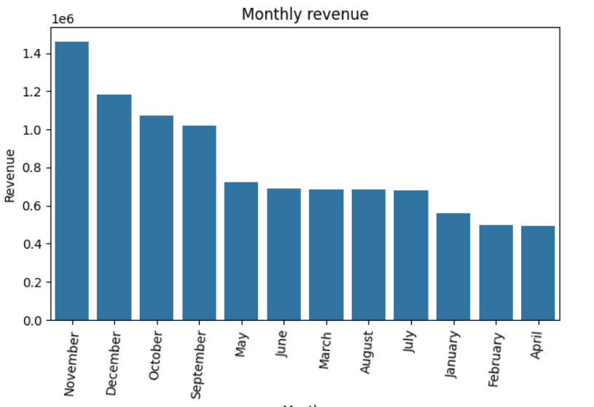
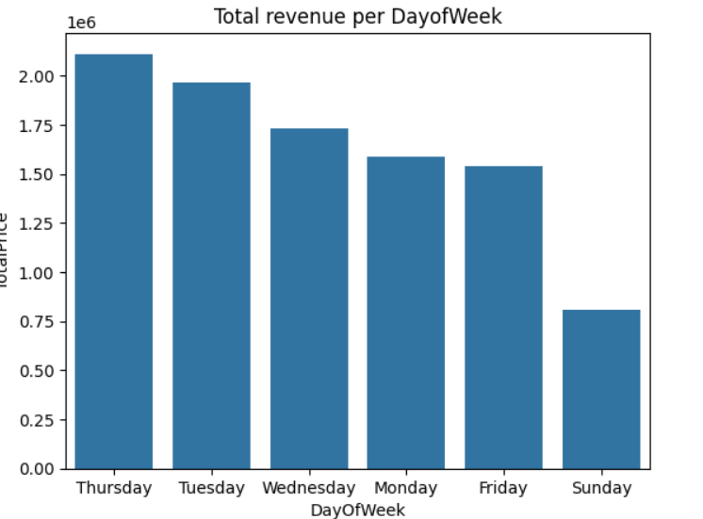
EDA (Exploratory Data Analysis)
Insights from EDA
Top-selling products.
Most active customers.
Peak sales by month/day/time.
Country-wise revenue.

Slide 6
SQL BASED ANALYSIS
Identify repeat customers.
Calculate monthly revenue.
Filter Cancelled invoices.
Segment customers based on total spend.

Slide 7
POWER BI DASHBOARD
Use KPIs:- Total revenue, Total customers, Total orders
Sales by country.
Monthly trend lines.
Product-wise revenue.
Customer segments chart.
Slicer for: Invoice cancelled or not.

Slide 8
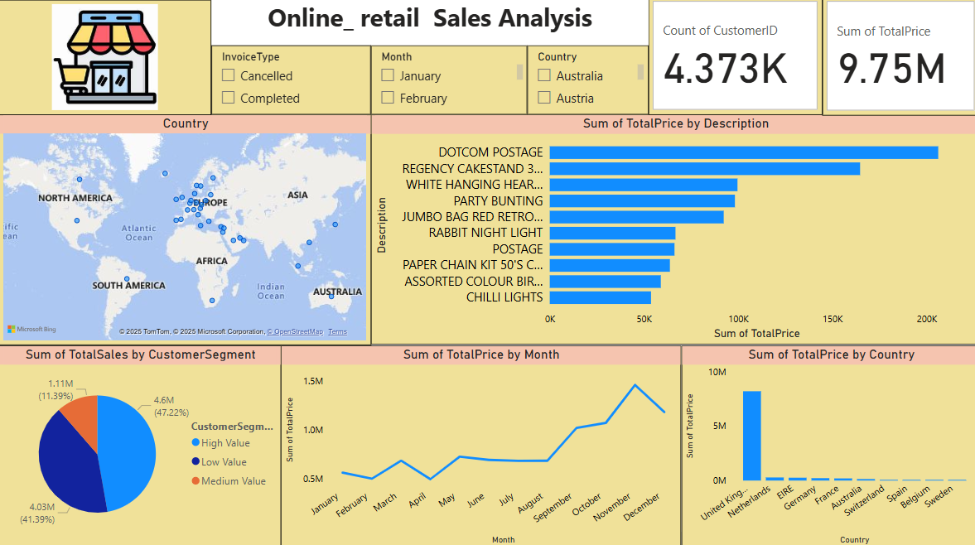

Slide 9
Key Business Insights
Significant numbers of cancelled orders.
Peak sales occur during November or December.
The UK dominates total sales.
Certain products are returned frequently.
A small number of products generate most of the revenue.
A small group of customers is responsible for a large portion of the revenue.

Slide 10
CONCLUSION
🔹 Transformed raw retail data into actionable business insights through EDA,
SQL and Power BI.
🔹 Discovered key trends in customer behavior, product performance, and seasonal sales patterns.
🔹 Identified high-value customers and high-return products, providing direction for targeted strategies.
🔹 Built a dynamic Power BI dashboard for real-time and interactive data-driven decision-making.
🔹 Demonstrated how data can drive strategic improvements in marketing, operations, and revenue growth
.

Slide 11
THANK YOU Any Questions?

